Slide 1
SQL Assessment Tool with IaaS Extensions

Slide 2

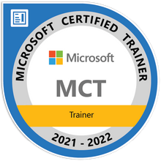
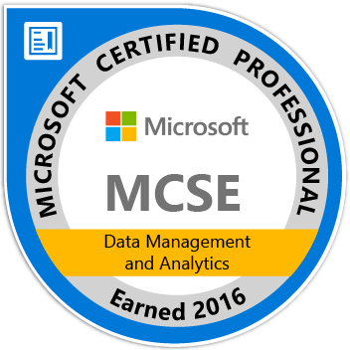
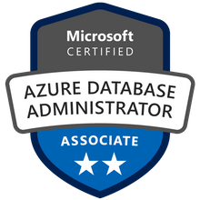



John Deardurff
Microsoft Customer Engineer (Global Technical Team)
Microsoft Certified Trainer (Regional Lead)
MVP: Data Platform (2016 – 2018)
Email: John.Deardurff@Microsoft.com
Twitter: @SQLMCT
Website: www.SQLMCT.com
GitHub: github.com\SQLMCT

Slide 3
What does this session cover?
What are SQL IaaS Extensions?
What is the SQL Assessment Tool?
Demo: Reviewing SQL Assessment Results
Questions?

Slide 4
What is the SQL Server IaaS Agent Extension?
Features
Unified experience in managing all of Azure SQL family.
Self-installs of SQL Server on an Azure virtual machine will need to register the SQL Server VM to install the SQL Server IaaS Agent Extension.
Registration
Deploying a SQL Server VM Azure Marketplace image through the Azure portal automatically registers the SQL Server VM with the resource provider
The SQL Server IaaS Agent Extension runs on Azure VMs.
Licensing
Self-installed VMs with IaaS extension automatically indicate usage of Azure Hybrid Benefit.
Save money by converting variable workloads with Software Assurance to PayGo images.
Ensure compliance with Azure terms and conditions without any extra effort.
Self-installed VMs with IaaS extensions can be easily converted to PayGo images.
Compliance
Automates task like Backups and Patching.
Enables customers to adopt PaaS-like capabilities with IaaS-based SQL Servers at no additional charge.
Notes:
The SQL Server IaaS Agent extension (SqlIaasExtension) runs on SQL Server on Windows Azure Virtual Machines (VMs) to automate management and administration tasks.
This article provides an overview of the extension. To install the SQL Server IaaS extension to SQL Server on Azure VMs, see the articles for Automatic installation, Single VMs, or VMs in bulk.
Note
Starting in September 2021, registering with the SQL IaaS extension in full mode no longer requires restarting the SQL Server service.
Overview
The SQL Server IaaS Agent extension allows for integration with the Azure portal, and depending on the management mode, unlocks a number of feature benefits for SQL Server on Azure VMs:
Feature benefits: The extension unlocks a number of automation feature benefits, such as portal management, license flexibility, automated backup, automated patching and more. See Feature benefits later in this article for details.
Compliance: The extension offers a simplified method to fulfill the requirement of notifying Microsoft that the Azure Hybrid Benefit has been enabled as is specified in the product terms. This process negates needing to manage licensing registration forms for each resource.
Free: The extension in all three manageability modes is completely free. There is no additional cost associated with the extension, or with changing management modes.
Simplified license management: The extension simplifies SQL Server license management, and allows you to quickly identify SQL Server VMs with the Azure Hybrid Benefit enabled using the Azure portal, PowerShell or the Azure CLI:

Slide 5
PaaS features for Azure SQL VMs
Features of SQL IaaS Extensions | Extensions enabled
 | Lightweight mode | Full mode
Visibility of SQL editions and configuration state via Portal Management
Visibility to the licensing of SQL Server instances
SQL IaaS/PaaS deployments managed in one location
SQL Server integration with Azure Key Vault
Automatic configuration of Always On for High Availability
Automated Patching (for critical updates)
Automated Backup (with Point-in-Time Restore)
Disk Scaling and Utilization view
Notes:
Feature benefits
The SQL Server IaaS Agent extension unlocks a number of feature benefits for managing your SQL Server VM.
The following table details these benefits:
Portal management: Unlocks management in the portal, so that you can view all of your SQL Server VMs in one place, and so that you can enable and disable SQL specific features directly from the portal. Management mode: Lightweight & full
Automated backup: Automates the scheduling of backups for all databases for either the default instance or a properly installed named instance of SQL Server on the VM. For more information, see Automated backup for SQL Server in Azure virtual machines (Resource Manager). Management mode: Full
Automated patching: Configures a maintenance window during which important Windows and SQL Server security updates to your VM can take place, so you can avoid updates during peak times for your workload. For more information, see Automated patching for SQL Server in Azure virtual machines (Resource Manager). Management mode: Full
Azure Key Vault integration: Enables you to automatically install and configure Azure Key Vault on your SQL Server VM. For more information, see Configure Azure Key Vault integration for SQL Server on Azure Virtual Machines (Resource Manager). Management mode: Full
View disk utilization in portal: Allows you to view a graphical representation of the disk utilization of your SQL data files in the Azure portal. Management mode: Full
Flexible licensing: Save on cost by seamlessly transitioning from the bring-your-own-license (also known as the Azure Hybrid Benefit) to the pay-as-you-go licensing model and back again. Management mode: Lightweight & full
Flexible version / edition: If you decide to change the version or edition of SQL Server, you can update the metadata within the Azure portal without having to redeploy the entire SQL Server VM. Management mode: Lightweight & full
Defender for Cloud portal integration: If you've enabled Microsoft Defender for SQL, then you can view Defender for Cloud recommendations directly in the SQL virtual machines resource of the Azure portal. See Security best practices to learn more. Management mode: Lightweight & full
SQL Assessment (Preview)Enables you to assess the health of your SQL Server VMs using configuration best practices. For more information, see SQL Assessment. Management mode: Full
Management modes
You can choose to register your SQL IaaS extension in three management modes:
Lightweight mode copies extension binaries to the VM, but does not install the agent. Lightweight mode only supports changing the license type and edition of SQL Server and provides limited portal management. Use this option for SQL Server VMs with multiple instances, or those participating in a failover cluster instance (FCI). Lightweight mode is the default management mode when using the automatic registration feature, or when a management type is not specified during manual registration. There is no impact to memory or CPU when using the lightweight mode, and there is no associated cost.
Full mode installs the SQL IaaS Agent to the VM to deliver full functionality. Use it for managing a SQL Server VM with a single instance. Full mode installs two Windows services that have a minimal impact to memory and CPU - these can be monitored through task manager. There is no cost associated with using the full manageability mode. System administrator permissions are required. As of September 2021, restarting the SQL Server service is no longer necessary when registering your SQL Server VM in full management mode.
NoAgent mode is dedicated to SQL Server 2008 and SQL Server 2008 R2 installed on Windows Server 2008. There is no impact to memory or CPU when using the NoAgent mode. There is no cost associated with using the NoAgent manageability mode, the SQL Server is not restarted, and an agent is not installed to the VM.

Slide 6
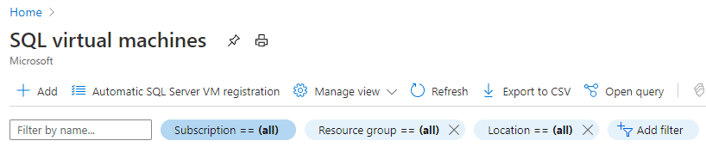
Automatic Azure SQL VM registration
Automatic SQL Server VM registration button enables SQL IaaS Extensions features for all SQL VMs within a given subscription automatically.
Activation will require consent of the person who performs activation.
Microsoft will not use this data for licensing audits without customer’s advance consent.
The SQL IaaS extensions will become active for all SQL Server VMs, and the features of lightweight mode will be activated within 24 hours after the activation.
Registering extension in full mode does not require restart of the server.
Notes:
Automatic SQL Server VM registration button enables SQL IaaS Extensions features for all SQL VMs within a given subscription automatically.
In order to activate this feature for multiple subscriptions, the bulk action script is available.
Activation will require consent of the person who performs activation.
The request for customer consent enables to-customer statement in the opt-in that data can’t be used for audit unless the customer agrees: “Microsoft will not use this data for licensing audits without customer’s advance consent.”.
The SQL IaaS extensions will become active for all SQL Server VMs, and the features of lightweight mode will be activated within 24 hours after the activation.
Registering extension in full mode does not require restart of the server.
Installation
Register your SQL Server VM with the SQL Server IaaS Agent extension to create the SQL virtual machine resource within your subscription, which is a separate resource from the virtual machine resource. Unregistering your SQL Server VM from the extension will remove the SQL virtual machine resource from your subscription but will not drop the actual virtual machine.
Deploying a SQL Server VM Azure Marketplace image through the Azure portal automatically registers the SQL Server VM with the extension in full. However, if you choose to self-install SQL Server on an Azure virtual machine, or provision an Azure virtual machine from a custom VHD, then you must register your SQL Server VM with the SQL IaaS extension to unlock feature benefits.
Registering the extension in lightweight mode copies binaries but does not install the agent to the VM. The agent is installed to the VM when the extension is installed in full management mode.
There are three ways to register with the extension:
Automatically for all current and future VMs in a subscription
Manually for a single VM
Manually for multiple VMs in bulk
By default, Azure VMs with SQL Server 2016 or later installed will be automatically registered with the SQL IaaS Agent extension when detected by the CEIP service. See the SQL Server privacy supplement for more information.

Slide 7
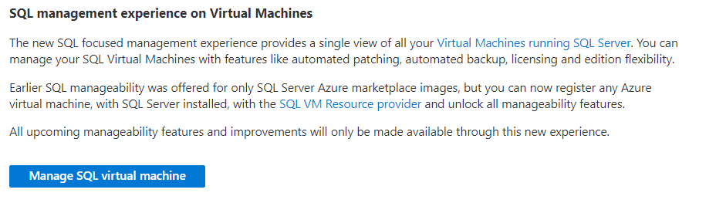
SQL VM Management Experience
Manage SQL Server configuration under the Virtual Machine blade.
Notes:
You can also manage SQL Server configuration under the Virtual Machine blade
SQL management experience on Virtual Machines
The new SQL focused management experience provides a single view of all your Virtual Machines running SQL Server. You can manage your SQL Virtual Machines with features like automated patching, automated backup, licensing and edition flexibility.
Earlier SQL manageability was offered for only SQL Server Azure marketplace images, but you can now register any Azure virtual machine, with SQL Server installed, with the SQL VM Resource provider and unlock all manageability features.
All upcoming manageability features and improvements will only be made available through this new experience.

Slide 8
SQL Assessment for SQL Server on Azure VMs
The SQL Assessment feature evaluates your SQL Server on Azure Virtual Machines (VMs) to identify possible performance issues and provide recommendations for indexing, statistics, deprecated features, missing trace flags, etc.
Results are uploaded to your Log Analytics workspace using the Microsoft Monitoring Agent.
To use the SQL Assessment feature, you must have the following prerequisites:
A Log Analytics workspace in the same subscription as your SQL Server VM
SQL Server needs to be 2012 or higher version.
Uses a large set of pre-defined rules provided by the SQL Assessment API to follow best practices.
SQL Server VM must be registered with the SQL Server IaaS extension in full mode.
Notes:
The SQL Assessment feature of the Azure portal identifies possible performance issues and evaluates that your SQL Server on Azure Virtual Machines (VMs) is configured to follow best practices using the rich ruleset provided by the SQL Assessment API.
The SQL Assessment feature is currently in preview.
Overview
Once the SQL Assessment feature is enabled, your SQL Server instance and databases are scanned to provide recommendations for things like indexes, deprecated features, enabled or missing trace flags, statistics, etc. Recommendations are surfaced to the SQL VM management page of the Azure portal.
Assessment results are uploaded to your Log Analytics workspace using Microsoft Monitoring Agent (MMA). If your VM is already configured to use Log Analytics, the SQL Assessment feature uses the existing connection. Otherwise, the MMA extension is installed to the SQL Server VM and connected to the specified Log Analytics workspace.
Assessment run time depends on your environment (number of databases, objects, and so on), with a duration from a few minutes, up to an hour. Similarly, the size of the assessment result also depends on your environment. Assessment runs against your instance and all databases on that instance.
Prerequisites
To use the SQL Assessment feature, you must have the following prerequisites:
Your SQL Server VM must be registered with the SQL Server IaaS extension in full mode.
A Log Analytics workspace in the same subscription as your SQL Server VM to upload assessment results to.
SQL Server needs to be 2012 or higher version.

Slide 9
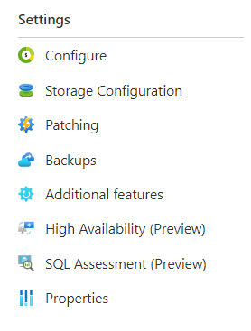
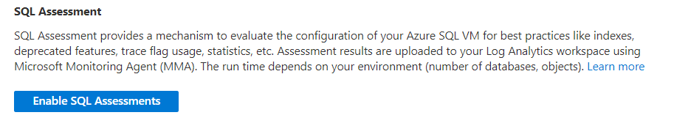
Enable SQL Assessments
Notes:
Enable
To enable SQL Assessments, follow these steps:
Sign into the Azure portal and go to your SQL Server VM resource.
Select SQL Assessments under Settings.
Select Enable SQL Assessments or Configuration to navigate to the Configuration page.
Check the Enable SQL Assessments box and provide the following:
The Log Analytics workspace that assessments will be uploaded to. If the SQL Server VM has not been associated with a workspace previously, then choose an existing workspace in the subscription from the drop-down. Otherwise, the previously-associated workspace is already populated.
The Run schedule. You can choose to run assessments on demand, or automatically on a schedule. If you choose a schedule, then provide the frequency (weekly or monthly), day of week, recurrence (every 1-6 weeks), and the time of day your assessments should start (local to VM time).
Select Apply to save your changes and deploy the Microsoft Monitoring Agent to your SQL Server VM if it's not deployed already. An Azure portal notification will tell you once the SQL Assessment feature is ready for your SQL Server VM.

Slide 10
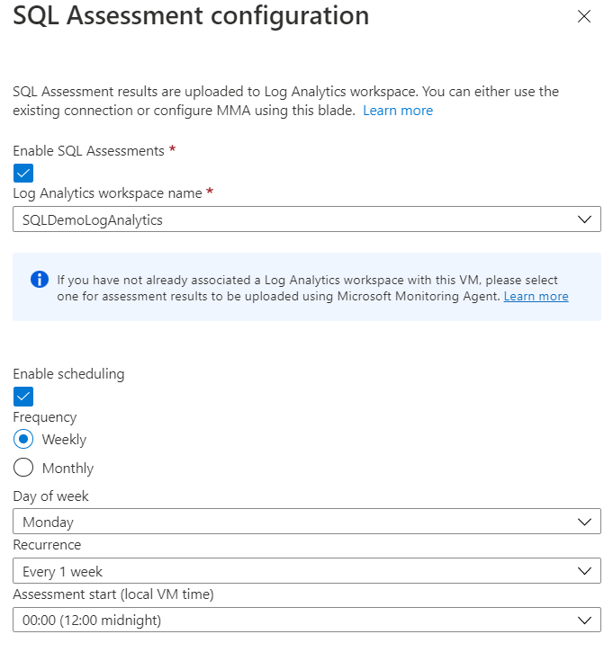
Configure SQL Assessments
Notes:
Enable
To enable SQL Assessments, follow these steps:
Sign into the Azure portal and go to your SQL Server VM resource.
Select SQL Assessments under Settings.
Select Enable SQL Assessments or Configuration to navigate to the Configuration page.
Check the Enable SQL Assessments box and provide the following:
The Log Analytics workspace that assessments will be uploaded to. If the SQL Server VM has not been associated with a workspace previously, then choose an existing workspace in the subscription from the drop-down. Otherwise, the previously-associated workspace is already populated.
The Run schedule. You can choose to run assessments on demand, or automatically on a schedule. If you choose a schedule, then provide the frequency (weekly or monthly), day of week, recurrence (every 1-6 weeks), and the time of day your assessments should start (local to VM time).
Select Apply to save your changes and deploy the Microsoft Monitoring Agent to your SQL Server VM if it's not deployed already. An Azure portal notification will tell you once the SQL Assessment feature is ready for your SQL Server VM.

Slide 11
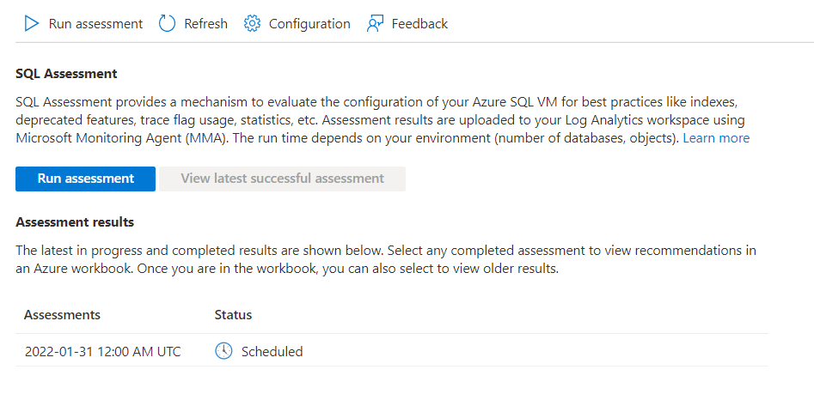
Run SQL Assessments
Notes:
Assess SQL Server VM
Assessments run:
On a schedule
On demand
Run scheduled assessment
If you set a schedule in the configuration blade, an assessment runs automatically at the specified date and time. Choose Configuration to modify your assessment schedule. Once you provide a new schedule, the previous schedule is overwritten.
Run on demand assessment
After the SQL Assessment feature is enabled for your SQL Server VM, it's possible to run an assessment on demand. To do so, select Run assessment from the SQL Assessment blade of the Azure portal SQL Server VM resource page.
Server on Azure VMs, see Manage SQL Server VMs by using the Azure portal

Slide 12
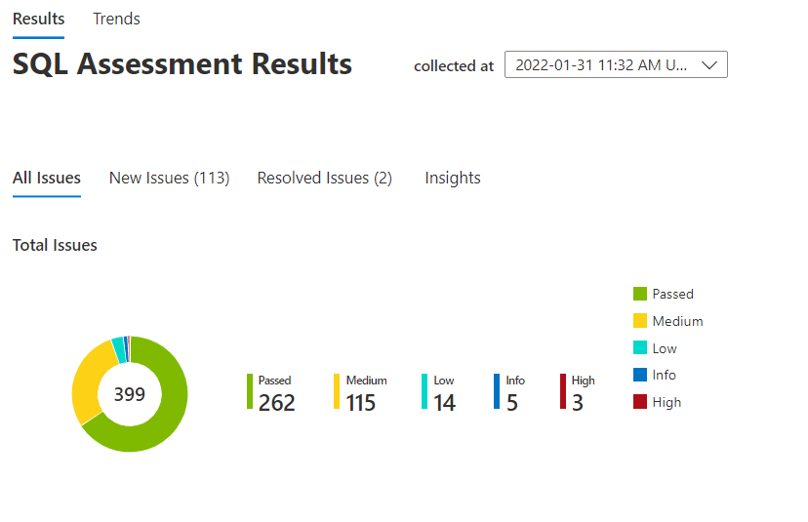
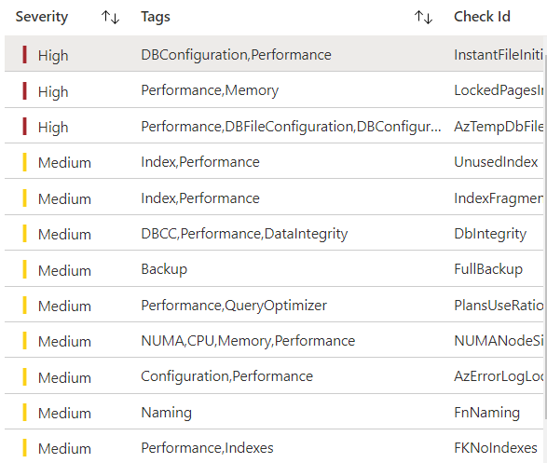
View SQL Assessments
Notes:
View results
The Assessments results section of the SQL Assessments page shows a list of the most recent assessment runs. Each row displays the start time of a run and the status - scheduled, running, uploading results, completed, or failed. Each assessment run has two parts: evaluates your instance, and uploads the results to your Log Analytics workspace. The status field covers both parts. Assessment results are shown in Azure workbooks.
Access the assessment results Azure workbook in three ways:
Select the View latest successful assessment button on the SQL Assessments page.
Choose a completed run from the Assessment results section of the SQL Assessments page.
Select View assessment results from the Top 10 recommendations surfaced on the Overview page of your SQL VM resource page.
Once you have the workbook open, you can use the drop-down to select previous runs. You can view the results of a single run using the Results page or review historical trends using the Trends page.
Results page
The Results page organizes the recommendations using tabs for All, new, resolved. Use these tabs to view all recommendations from the current run, all the new recommendations (the delta from previous runs), or resolved recommendations from previous runs. Tabs help you track progress between runs. The Insights tab identifies the most recurring issues and the databases with the most issues. Use these to decide where to concentrate your efforts.
The graph groups assessment results in different categories of severity - high, medium, and low. Select each category to see the list of recommendations, or search for key phrases in the search box. It's best to start with the most severe recommendations and go down the list.
Sort by Name in the table to view recommendations grouped by a particular database or instance. Use the search box to view certain types of recommendations based on the tag value or key phrase, such as performance. Use the down arrow at the top-right of the table to expert results to an excel file.
The passed section of the graph identifies recommendations your system already follows.
View detailed information for each recommendation by selecting the Message field, such as a long description, and relevant online resources.
Trends page
There are three charts on the Trends page to show changes over time: all issues, new issues, and resolved issues. The charts help you see your progress. Ideally, the number of recommendations should go down while the number of resolved issues goes up. The legend shows the average number of issues for each severity level. Hover over the bars to see the individual vales for each run.
If there are multiple runs in a single day, only the latest run is included in the graphs on the Trends page.
Known Issues
You may encounter some of the following known issues when using SQL assessments.
Configuration error for Enable Assessment
If your virtual machine is already associated with a Log Analytics workspace that you don't have access to or that is in another subscription, you will see an error in the configuration blade. For the former, you can either obtain permissions for that workspace or switch your VM to a different Log Analytics workspace by following these instructions to remove Microsoft Monitoring Agent. We are working on enabling the scenario where the Log Analytics workspace is in another subscription.
Deployment failure for Enable or Run Assessment
Refer to the deployment history of the resource group containing the SQL VM to view the error message associated with the failed action.
Failed assessments
If the assessment or uploading the results failed for some reason, the status of that run will indicate the failure. Clicking on the status will open a context pane where you can see the details about the failure and possible ways to remediate the issue.
Tip
If you have enforced TLS 1.0 or higher in Windows and disabled older SSL protocols as described here, then you must also ensure that .NET Framework is configured to use strong cryptography.
Next steps
To register your SQL Server VM with the SQL Server IaaS extension to SQL Server on Azure VMs, see the articles for Automatic installation, Single VMs, or VMs in bulk.
To learn about more capabilities available by the SQL Server IaaS extension to SQL Server on Azure VMs, see Manage SQL Server VMs by using the Azure portal

Slide 13
Demonstration

Slide 14
Questions?

Slide 15
